Slide 1
CALENDARIO
DE LAS
EMOCIONES
2018
feliz
triste

Slide 2
ENERO
2018
,
ALEGRIA
LUNES | MARTES | MIÉRCOLES | JUEVES | VIERNES | SÁBADO | DOMINGO
1 | 2 | 3 | 4 | 5 | 6 | 7
8 | 9 | 10 | 11 | 12 | 13 | 14
15 | 16 | 17 | 18 | 19 | 20 | 21
22 | 23 | 24 | 25 | 26 | 27 | 28
29 | 30 | 31

Slide 3
FEBRERO
2018
LUNES | MARTES | MIÉRCOLES | JUEVES | VIERNES | SÁBADO | DOMINGO
 |  |  | 1 | 2 | 3 | 4
5 | 6 | 7 | 8 | 9 | 10 | 11
12 | 13 | 14 | 15 | 16 | 17 | 18
19 | 20 | 21 | 22 | 23 | 24 | 25
26 | 27 | 28
ASOMBRO

Slide 4
MARZO
2018
,
LUNES | MARTES | MIÉRCOLES | JUEVES | VIERNES | SÁBADO | DOMINGO
 |  |  | 1 | 2 | 3 | 4
5 | 6 | 7 | 8 | 9 | 10 | 11
12 | 13 | 14 | 15 | 16 | 17 | 18
19 | 20 | 21 | 22 | 23 | 24 | 25
26 | 27 | 28 | 29 | 30 | 31
DECEPCION

Slide 5
ABRIL
2018
MIEDO
LUNES | MARTES | MIÉRCOLES | JUEVES | VIERNES | SÁBADO | DOMINGO
 |  |  |  |  |  | 1
2 | 3 | 4 | 5 | 6 | 7 | 8
9 | 10 | 11 | 12 | 13 | 14 | 15
16 | 17 | 18 | 19 | 20 | 21 | 22
23 | 24 | 25 | 26 | 27 | 28 | 29
30

Slide 6
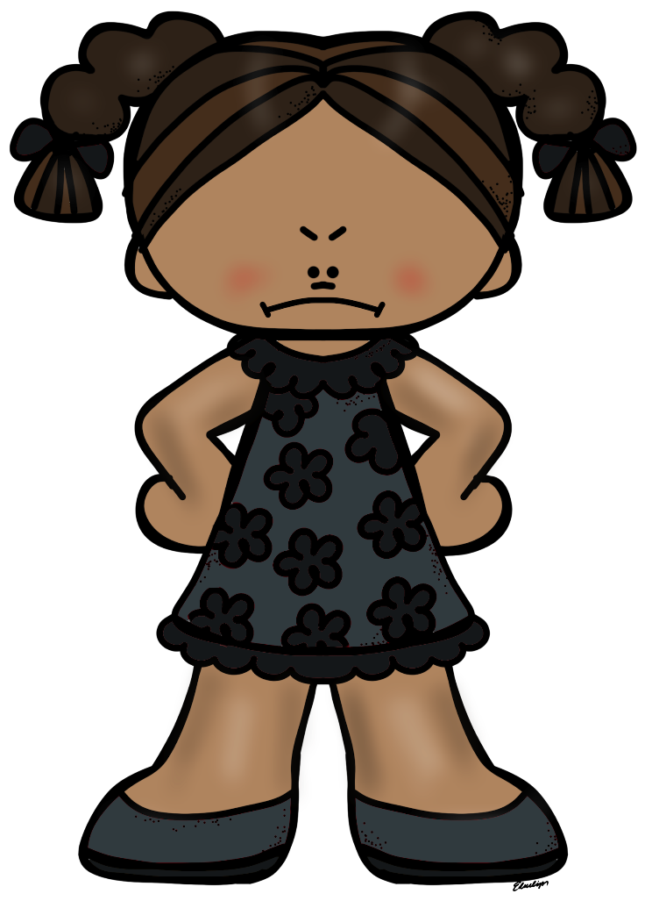
MAYO
2018
LUNES | MARTES | MIÉRCOLES | JUEVES | VIERNES | SÁBADO | DOMINGO
 | 1 | 2 | 3 | 4 | 5 | 6
7 | 8 | 9 | 10 | 11 | 12 | 13
14 | 15 | 16 | 17 | 18 | 19 | 20
21 | 22 | 23 | 24 | 25 | 26 | 27
28 | 29 | 30 | 31
ENDADO

Slide 7
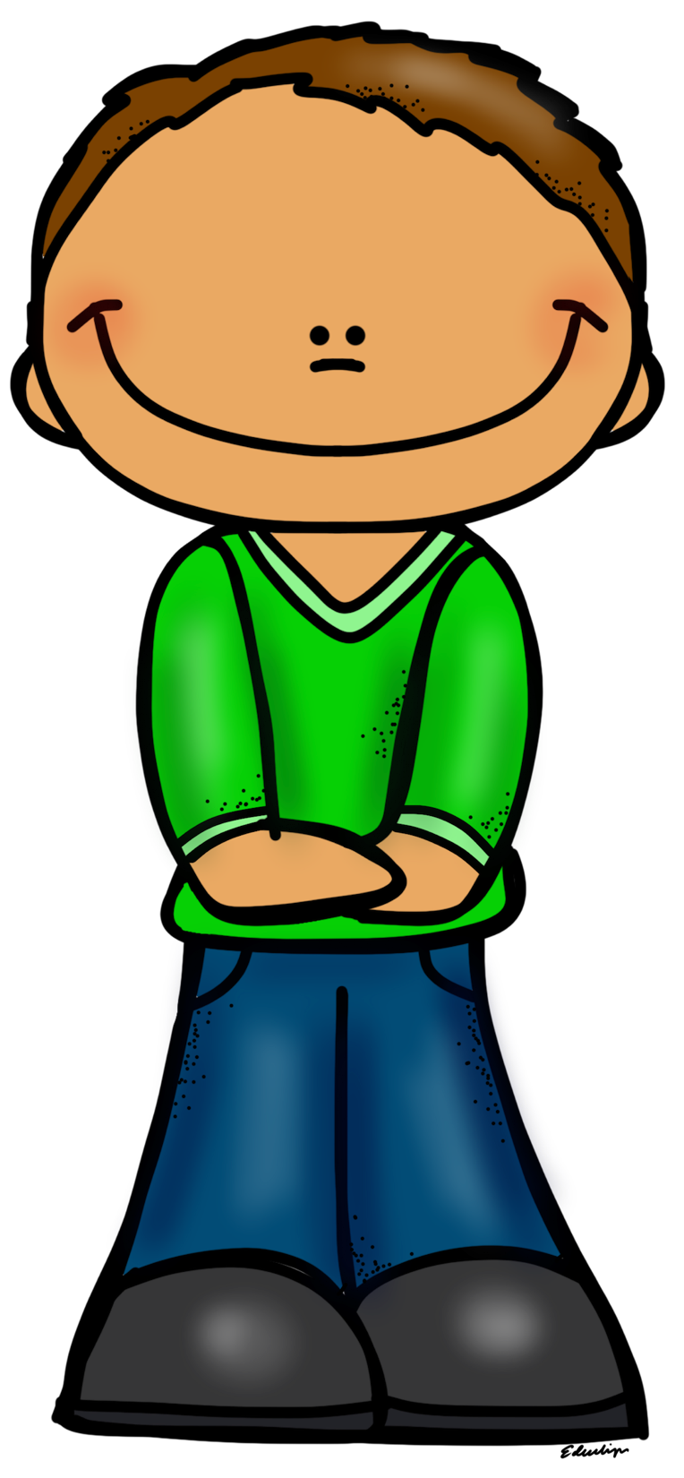
JUNIO
2018
AMOR
LUNES | MARTES | MIÉRCOLES | JUEVES | VIERNES | SÁBADO | DOMINGO
 |  |  |  | 1 | 2 | 3
4 | 5 | 6 | 7 | 8 | 9 | 10
11 | 12 | 13 | 14 | 15 | 16 | 17
18 | 19 | 20 | 21 | 22 | 23 | 24
25 | 26 | 27 | 28 | 29 | 30

Slide 8
JULIO
2018
SOLEDAD
LUNES | MARTES | MIÉRCOLES | JUEVES | VIERNES | SÁBADO | DOMINGO
 |  |  |  |  |  | 1
2 | 3 | 4 | 5 | 6 | 7 | 8
9 | 10 | 11 | 12 | 13 | 14 | 15
16 | 17 | 18 | 19 | 20 | 21 | 22
23 | 24 | 25 | 26 | 27 | 28 | 29
30 | 31

Slide 9
AGOSTO
2018
TIMIDEZ
LUNES | MARTES | MIÉRCOLES | JUEVES | VIERNES | SÁBADO | DOMINGO
 |  | 1 | 2 | 3 | 4 | 5
6 | 7 | 8 | 9 | 10 | 11 | 12
13 | 14 | 15 | 16 | 17 | 18 | 19
20 | 21 | 22 | 23 | 24 | 25 | 26
27 | 28 | 29 | 30 | 31

Slide 10
SEPTIEMBRE
2017
LUNES | MARTES | MIÉRCOLES | JUEVES | VIERNES | SÁBADO | DOMINGO
 |  |  |  |  | 1 | 2
3 | 4 | 5 | 6 | 7 | 8 | 9
10 | 11 | 12 | 13 | 14 | 15 | 16
17 | 18 | 19 | 20 | 21 | 22 | 23
24 | 25 | 26 | 27 | 28 | 29 | 30
SORPRESA

Slide 11
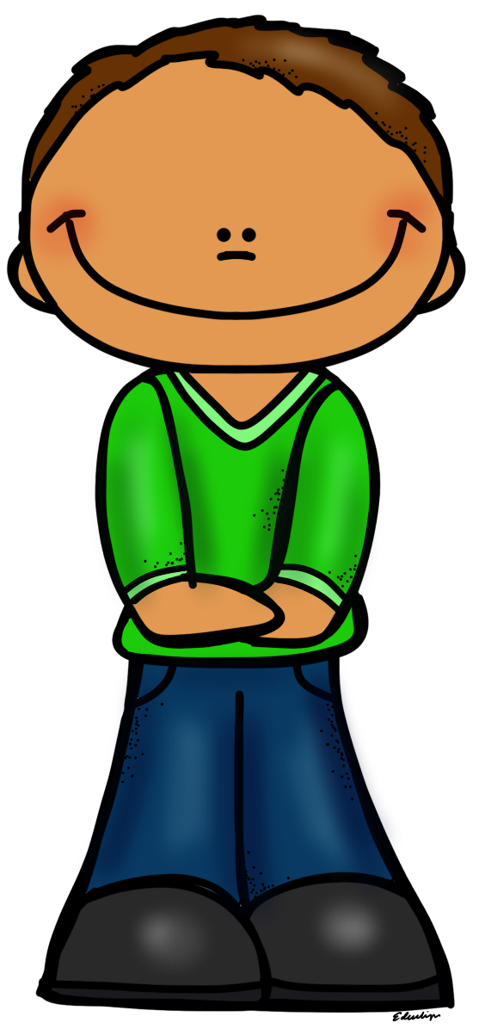
OCTUBRE
2016
LUNES | MARTES | MIÉRCOLES | JUEVES | VIERNES | SÁBADO | DOMINGO
1 | 2 | 3 | 4 | 5 | 6 | 7
8 | 9 | 10 | 11 | 12 | 13 | 14
15 | 16 | 17 | 18 | 19 | 20 | 21
22 | 23 | 24 | 25 | 26 | 27 | 28
29 | 30 | 31
FELICIDAD

Slide 12
NOVIEMBRE
2018
LUNES | MARTES | MIÉRCOLES | JUEVES | VIERNES | SÁBADO | DOMINGO
 |  |  |  |  | 1 | 2
3 | 4 | 5 | 6 | 7 | 8 | 9
10 | 11 | 12 | 13 | 14 | 15 | 16
17 | 18 | 19 | 20 | 21 | 22 | 23
24 | 25 | 26 | 27 | 28 | 29 | 30
31
ENFADO

Slide 13
DICIEMBRE
2018
LUNES | MARTES | MIÉRCOLES | JUEVES | VIERNES | SÁBADO | DOMINGO
 |  |  |  | 1 | 2 | 3
4 | 5 | 6 | 7 | 8 | 9 | 10
11 | 12 | 13 | 14 | 15 | 16 | 17
18 | 19 | 20 | 21 | 22 | 23 | 24
25 | 26 | 27 | 28 | 29 | 30 | 31
TRISTEZA

